Slide 1
Creating an Alberta Pension Plan – An APP
Good For Albertans and Alberta and…
good for the rest of Canada too…

Slide 2
Topics to be covered:
A Very Brief Introduction of myself and Libertas Alberta
Some terms we need to understand...
A brief history of Public Pensions and the CPP
What is Alberta’s – and Albertan’s – share of the CPP Fund
What are the implications of that Share compared to the actuarial need.
And what would an APP mean for Albertans - working and retired - and those who employ them.
The CPP and how it is managed
The concerns Canadians should have about the CPP
How an Alberta Pension Plan should be managed

Slide 3
A Very Brief Introduction of myself and Libertas Alberta
To develop Policies and successful Pathways for their implementation that will:
Expand Freedom in Alberta

Slide 4
Some terms we need to understand
Defined Benefit Pension versus Defined Contribution or Money Purchase plans…
Actuarial versus ‘simple’ math calculations
Private Equity (Private Placement) versus public ally-traded assets
Mark to market
Settlement Options
Liquidity
Management expense ratio (MER)

Slide 5
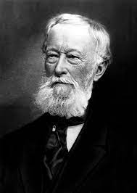
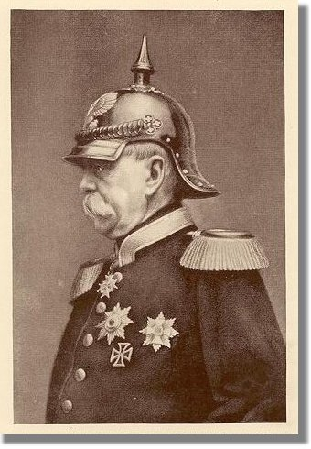
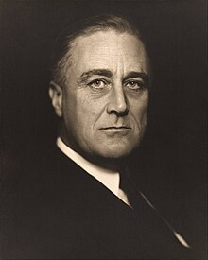
A Brief History of Pensions and the CPP
1855 - Alfred Krupp
1889 - Chancellor Otto von Bismarck
1935 Franklin Roosevelt
First Employer-sponsored Retirement Plan
First Government-run Worker’s Plan
Created US Social Security Pension

Slide 6
A Brief History continued…
1965 – The Canada Pension Plan is created.
In part because of competitive pressures of Canada’s Branch plant economy – the need to stay competitive with the US.
Important sidenote – The US’s social security has always been a pay as one goes program – there is no reserve investment for future payouts – And they are due to ‘hit the wall’ in about a decade when working American’s contributions will not be enough to pay the pensions being collected – thus debt and ultimately, taxes will have to go up. A lot. More on this later…

Slide 7
A Brief History of the CPP
The contract:
Law Creating it in 1965
Began operation in 1966
Under a Key difference between the US and Canada…
Pensions Are 100% provincial jurisdiction with one exception…
Private Nationally-incorporated firms
It is a joint-operating agreement – not a unitary pension plan
Nine provinces sign on while Quebec declines and sets up its own pension plan (QPP) that essentially mirrors the defined benefit that is paid

Slide 8
A Brief History of the CPP continued…
Why not operate separately?
A typical mainframe computer in 1965 was over $1,000,000 - not including the building it would need to be housed in and the many people to operate it. The entire Newfoundland budget was 111 million.

Slide 9
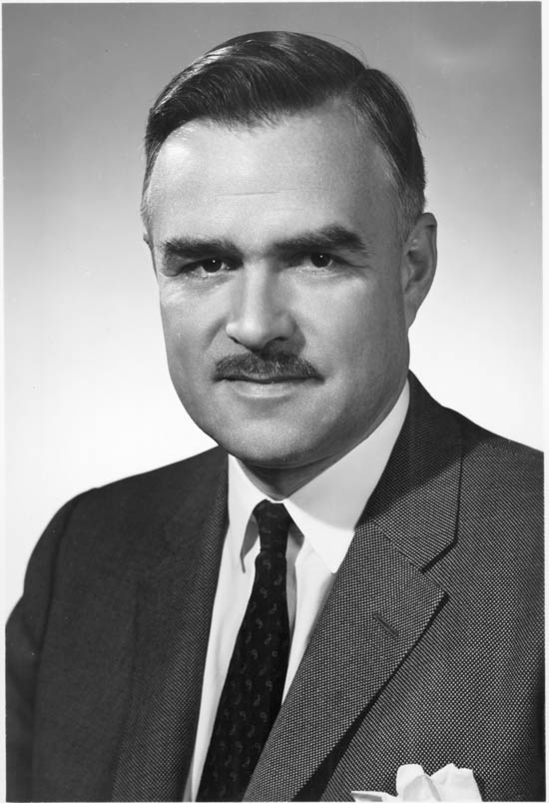
A Brief History of the CPP continued…
It has been granted a monopoly on investment management of the funds for almost 60 years.
Segregated accounts for each province from the very beginning
It was the reason the Social Insurance Number – A.K.A SIN - was created.
Tracked each individual’s contributions AND what province they were working in when they made those contributions.
Every participating province has the right to exit the CPP and create its own pension – multi-year process
Premier John Robarts of Ontario insisted on this. At the time Ontario was a rapidly-growing young province and was far and away the most significant province in the CPP.

Slide 10
Exiting the CPP agreement…
Retraction/Exit formula is ‘simple’ math:
Contributions + Growth on the Invested Contributions – Payments Made to contributors
There is NO ACTUARIAL calculation
A note on Actuarial Science
Actuarial Calculations are “complex” math.
It requires modelling of data to estimate how much needs to be accumulated in funds to pay off future obligations.
Things like birth and immigration rates, life expectancy, disability rates, investment and inflation trends.
Very ‘Grey’ and very error-prone.

Slide 11
The Retraction Exit Formula
According to several sources, were the APP to be created the transfer from the CPP would be approximately 50% of the fund.
According to the CCPIB the Fund value is $570 billion (September 2023)
IF that is the fund value the transfer would be about 285 billion*
Note – the process would take several years – as that is part of the CPP contract, AND
The transfer won’t just be a ‘check’ for that amount but rather a transfer of assets*
* more on both later…

Slide 12
Back to the Actuarial discussion…
Simply put the more contributors one has compared to those receiving benefits the less contributions are required and the lower the reserve fund needs to be.
The CPP has been pooling all provincial funds and making required contribution and reserve calculations based on the Demographics of The 9 provinces in the CPP COMBINED.
But Alberta is far younger and has far more contributions coming and far fewer funds paid out than any other province.
Thus, Actuarially Alberta needs far less contributions and reserve funds than it owns in the CPP fund.
It has a very large actuarial fund surplus and Albertans have been paying a much higher income deduction into the fund than is required.
IOW Aggregated nationally it has meant a transfer – into the billions of dollars from Alberta to eastern provinces – and has been for decades.

Slide 13
Actuarial Discussion continued…
Meanwhile other provinces – Newfoundland and Labrador and PEI and others have the exact opposite situation –
they have a significant actuarial deficit
The reality is: Albertans have been subsidizing other province’s CPP programs.
The troubling thing is that many many Albertans have contributed far more into the CPP than they needed to.
The Difference between the severed amount and the Actuarial required amount - an amount possibly above 100 billion dollars…
Is money that should have been paid to Albertans or not taken from Albertans.
Including many thousands of Albertans who have passed on.

Slide 14
Actuarial Discussion continued…
Going forward, because of this actuarial surplus in an APP two things would need to happen:
Contribution rates would have to be decrease for those not yet receiving a pension.
The amount being paid to those already receiving a pension would have to be increased – a refund of overpayments they made when they were working.
The exact numbers obviously need to be calculated, but they are not insignificant changes in either case.
A reduction of the combined Employee and Employer contribution rate by 4% does not sound unreasonable.
This would be the case regardless of the actuarial surplus
And an immediate increase in Pension payments of 10% also seems manageable and sustainable.
probably for several decades before the actuarial surplus would be refunded.

Slide 15
Back to US Social Security…
Operated very differently…
No investment element – Meant to be a pay as you go system – contributions have to be at least as much as what is being paid out.
What has happened is the contribution levels stayed flat –
causing a surplus in early years –
but now and for several years it has been running a deficit and in less than a decade the benefit will have to be paid not just from contributions
but also from government revenues (Increasing the deficit and debt even further) AKA an unfunded liability.

Slide 16
The CPP Contribution Rate…
The CPP was in similar difficulties - had an unfunded future liability – and wasn’t taking in enough contributions. That was corrected starting in 1986 by increasing the deduction by about 300% from 3.6% to 10%.
Effective in 2024 that rate is now 12%
Side bar/FYI – The contribution is 50% paid via the Employer and 50% by the Employee – and the deductions are remitted to the CPP directly by the Employer ‘as-earned’.

Slide 17
The CPP Contribution Rate Continued...
The increase to 12% is being done to…
“finance the expanded pensions and maintain the soundness of the plan, contributions to the CPP from workers and their employers will each rise 1 per cent from current levels, to 5.95 per cent over the existing band of covered earnings.
This increase will be phased in over 5 years, starting in 2019.
The increase to the earnings threshold will be phased in over 2 years, starting in 2024”

Slide 18
The CPP Contribution Rate Continued...
“The primary CPP benefit is the monthly retirement pension.
Currently, (pre 2024) this is equal to 25 per cent of the average earnings on which CPP contributions were made over the entire working life of a contributor from age 18 to 65 in constant dollars.
The earnings upon which contributions are made are subject to an annual limit, which, in 2020, is $58,700.
However, under changes being phased in by 2025, the pension benefit will rise to 33.33 per cent of earnings on which contributions were made,
and the maximum amount of income covered by the CPP will rise by 14 percent from the projected 2025 limit of $69,700 to $79,400.”

Slide 19
The CPP Contribution Rate Continued...
Some consider these changes a good thing…
Others do not.
It means:
More government control – less flexibility in how one saves for retirement
More incentive for Employees and business owners to ”opt out” via contracting and getting ‘paid’ via dividends

Slide 20
A critique of the CPP
Four huge issues:
The CPP is expensive
The CPP fund has become unwieldy – unable to efficiently play in the market system
Liquidity – lack of transparency.
It is not accountable.

Slide 21
The CPP is expensive
They employ over 2000 people (as per their own annual reports)
An all-in annual operating cost of well over 2 billion – likely over 3 billion – per year.
Translated to terms investors are familiar with – that’s over a 0.5% Management Expense Ratio (MER)
Considering the size of the fund under management and the economy of scale that that should deliver, along with almost half of the current fund being in non-trading assets – real estate and private equity where the transaction costs are absorbed by the seller and the assets are intended to be held for the very long term, 0.5% is a very high MER.

Slide 22
The CPP is expensive continued…
There should be no marketing costs for the CPP – All wage-earning Canadians by law are required to contribute
Yet they spend approximately 40 million per year on advertising
They are not burdened by annual reporting and other mailings to be done and the myriad other service demands individual investment clients require that the CPP does not have to do.

Slide 23
The CPP is expensive continued…
By comparison, a person can buy $1000 of a Vanguard managed balanced fund with a 0.41% MER. Index-linked funds can have an MER as low as 0.05% (!!).

Slide 24
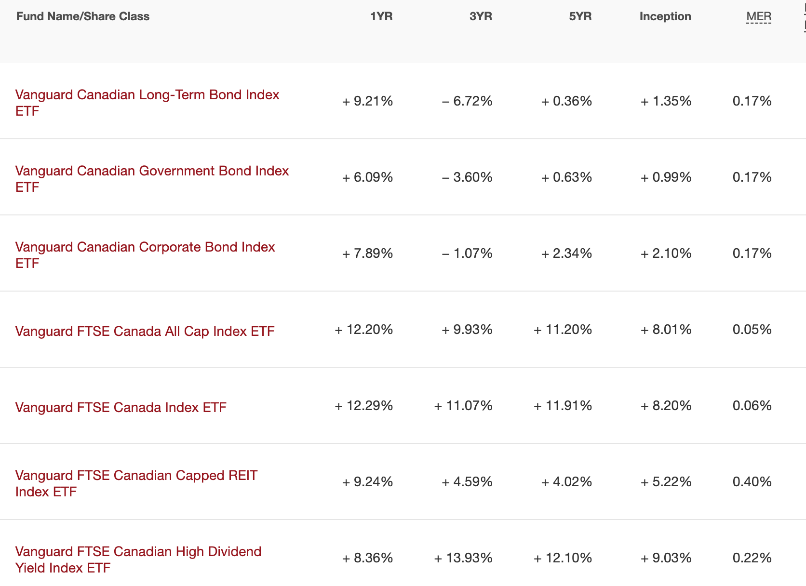
The CPP is expensive continued…

Slide 25
The CPP fund has become unwieldy
Due to its sheer size, it is unable to efficiently play in the market system.
Portfolios that have too many individual ownership positions dilute their ability to capture growth.
But buying only a manageable number of publicly-traded stocks or bonds means simply by acquiring or selling into a position distorts the market
Essentially they buy high and sell low

Slide 26
The CPP fund has become unwieldy continued…
This has, along with some accounting and actuarial rule changes, incentivized the CPP to move away from publicly-traded assets and into Private Placements, Real Estate and Infrastructure.
More on that next…

Slide 27
Liquidity – lack of transparency.
There have been several accounting and actuarial reserve rule changes brought on by several market upheavals that have happened over the past 30+ years:
Hurricane Andrew and the ‘scandalous’ collapse of Girling Re
Enron and other accounting scandals –early 2000s
The sub-prime crisis 2008
One of the primary outcomes for insurance and pension managers was that investments had to be “marked to market” on a daily basis.

Slide 28
Liquidity – lack of transparency continued...
This caused a lot of volatility and “strain” on the actuarial requirements and literally the values of the companies themselves
Some very smart people say that it was the M2M requirements that precipitated the financial market collapse of 2008.
It created a huge incentive to move away from publicly-traded assets to ones that are not. This eliminates the “mark to market” issue.
This also made accurate valuations of these pension funds impossible.

Slide 29
Liquidity – lack of transparency continued...
Here is what the CPP stated in its 2003 Annual report:
“Private Equities - While private equities are a small component of total CPP assets, they can contribute exceptional returns over the long term for the extra risk involved. However, these specialized investments need time to deliver full value. Our ultimate goal is to invest as much as 10 percent of CPP assets in private equities, subject to the availability of opportunities with acceptable risk/return profiles.” (Emphasis mine.)

Slide 30
Liquidity – lack of transparency continued...
And Again in 2003…
“Real Estate and Infrastructure Assets - The final component of our asset diversification strategy to date is real estate. Coupled with infrastructure assets, they may comprise as much as five percent of total CPP assets in the future.” (page 15)

Slide 31
Liquidity – lack of transparency continued...
Currently (circa spring 2023) the Fund’s reported holdings are:
9% in real estate and Private Equity holdings are 33% (!!). That’s over three times more Private Equity than they considered responsible exposure 20 years ago.
Coupled with infrastructure investments of 9%, today 51% of the CPP’s holdings are not publicly-traded and by definition are illiquid.

Slide 32
Liquidity – lack of transparency continued...
They are also valued very opaquely:
The only valuations have been done by third parties being paid by the CPP to conduct the valuations – hardly true arm’s length.
(page 11 of the 2023 annual report)

Slide 33
It is not accountable.
There are many who consider this to be a very risky option for these kind of funds as the managers are highly unlikely to be held to account for any mistakes or failings in these investments as they may not fail for decades to come.

Slide 34
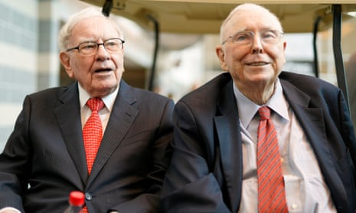
It is not accountable.
Who are some of these many?
Warren Buffett: Private Equity Firms Are Typically Very Dishonest
https://www.youtube.com/watch?v=r3_41Whvr1I

Slide 35
It is not accountable.
The results of private equity in pensions can be disastrous for pensioners:
Nebraska state auditor finds more than $1.4 billion in retirement funds for Omaha Public Schools mismanaged
https://www.ketv.com/article/nebraska-state-auditor-retirement-funds-omaha-public-schools-mismanaged/44301799

Slide 36
It is not accountable.
Mission Creep:

Slide 37
It is not accountable continued…
Mission Creep:
From the link under the “Read More” button:
“At CPP Investments, we have committed to attaining net-zero greenhouse gas (GHG) emissions across all scopes¹ in our operations and portfolio by 2050. We seek to do this while fulfilling our mandate of maximizing returns without undue risk of loss, taking into account the factors that may affect the funding of the Canada Pension Plan and its ability to meet its financial obligations.”
Bluntly - that is an express dilution of their mandate.

Slide 38
Things we can do better… that the CPP managers seem uninterested in doing
How an Alberta Pension Plan should be managed
Protect APP from political interference
No DIA or ESG mandates for example…
Or “Road to Zero” investment directives…
No direct investing in Alberta
Cannot/Should not be an Alberta economic development fund
Arms length investment managers

Slide 39
Things we can do better… that the CPP managers seem uninterested in doing
How an APP should be managed continued…
The mandate of the fund managers is simple and should be inviolable:
Maximize returns without undue risk of loss.
(From the CPP Annual Report…)

Slide 40
Things we can do better… that the CPP managers seem uninterested in doing
How an APP should be managed continued…
Complete Transparency:
Mandate that only publicly-traded entities that are not single asset purchases (IOW no individual stock or bond purchases)
Primarily Exchange Traded Index Funds and Index Funds (aka ETFs)
Always can be marked to market
Very low cost
Acquiring or disposing of them will not distort the market
Potential for corruption is nil.

Slide 41
Things we can do better… that the CPP managers seem uninterested in doing
How an APP should be managed continued…
Third party managers only:
Contract a group pension fund managers – 3 to 5 perhaps.
Review their performance every 3 to 5 years
and fire those that underperform.

Slide 42
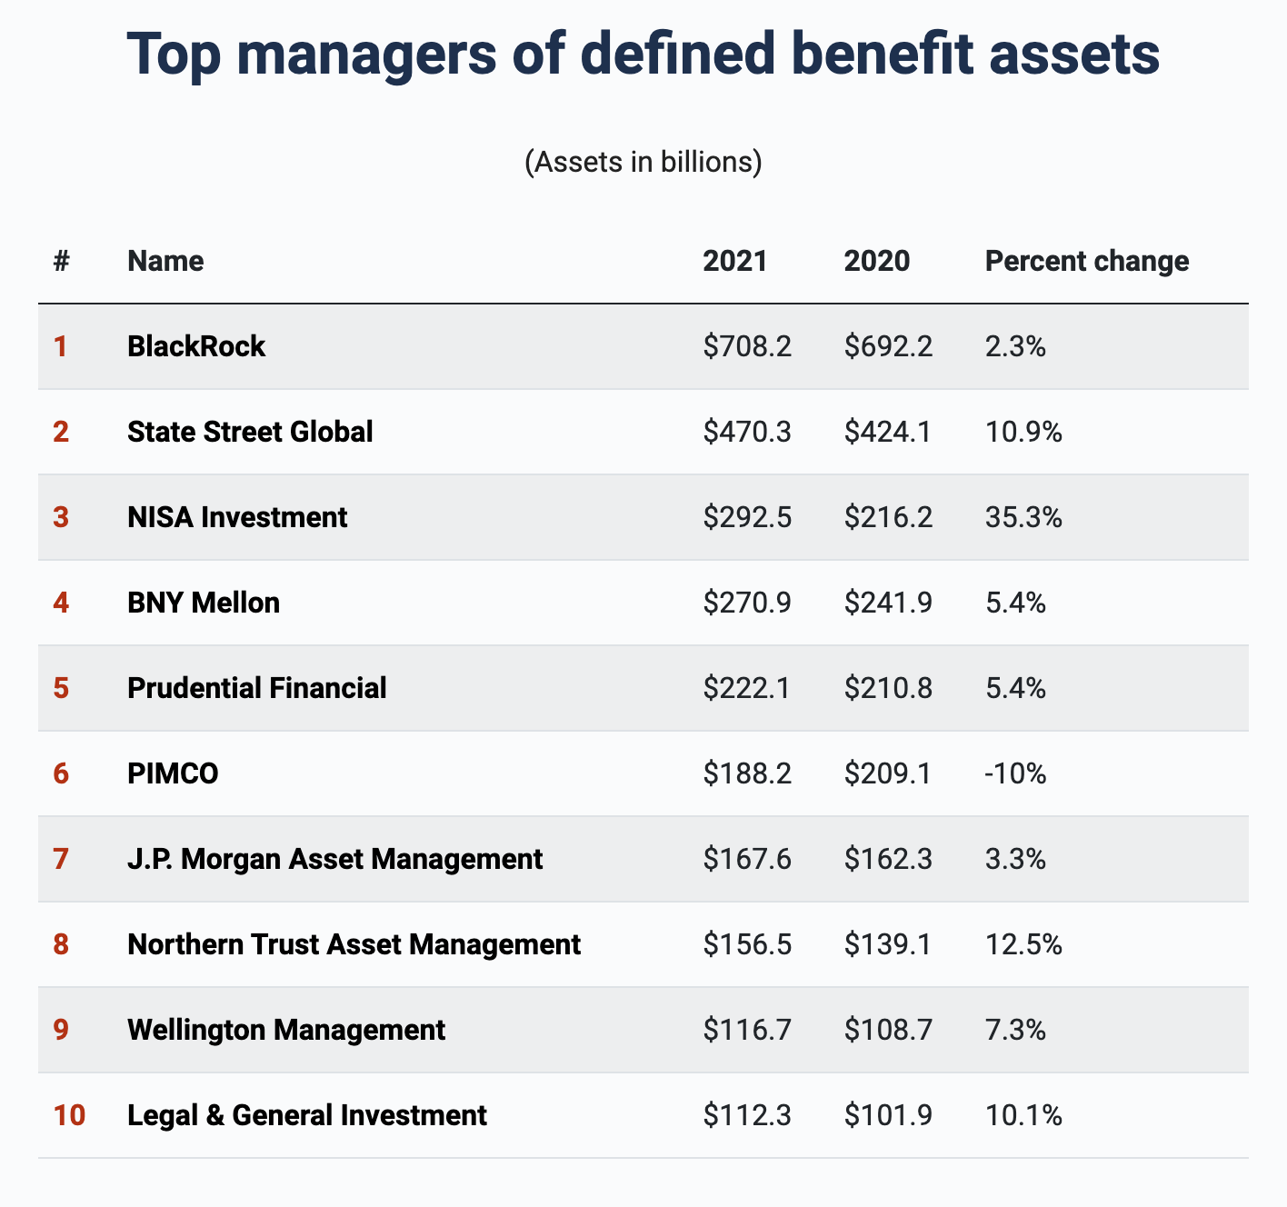
Things we can do better… that the CPP managers seem uninterested in doing
How an APP should be managed continued…
Who are these potential fund managers?

Slide 43
How an APP should be managed continued…
Who are these potential fund managers?
…And Private Canadian Pension managers like Sunlife, Manulife and Canada Life

Slide 44
Things we can do better… that the CPP managers seem uninterested in doing
How an APP should be managed continued…
Realtime reporting in assets would be possible.
In the future pension payout options could be introduced:
Conversion to an individual Locked-In Retirement Accounts (LIRA) with maximum annual payouts but the remaining balance can be part of one’s estate.
Make it possible for Self-employed/contract Albertan workers to contribute or purchase their way into an APP
Mirror Funds – the APP managed accounts could themselves become ETFs

Slide 45
Things we can do better… that the CPP managers seem uninterested in doing
APP Advantages
Lower Contribution rates; higher pensions paid
Transparency
Accountability
Not a monopoly on management
Alberta becomes a less expensive place to work and run a business
Exposure of CPP practices will make it more accountable and ultimately a better, safer manager of people’s pensions
One less thorn in the side – of Alberta Re; this confederation

Slide 46
A review…
A brief history of Public Pensions and the CPP
What is Alberta’s – and Albertan’s – share of the CPP Fund
What are the implications of that Share compared to the actuarial need.
And what would an APP mean for Albertans - working and retired - and those who employ them.
The CPP and how it is managed
The concerns Canadians should have about the CPP
How an Alberta Pension Plan should be managed
Benefits of an APP for Albertans, Alberta and Canada

Slide 47
Thank you for your time…
and patience…

